Slide 1
Using pediatric videos to make a real-world comprehensive final exam
2023 ICE Webinar Series
Melissa Turpin, OTD, OTR/L, CTP
Assistant Professor
admissions coordinator
Presbyterian College

Slide 2
Learning Objectives
By the end of this webinar, learners will be able to:
Facilitate student learning and clinical reasoning skills by using experience-dependent neuroplasticity principles & ICE videos.
Implement innovative teaching methods to promote student success with SOAP note documentation skills.
Build teaching confidence and competence by using ICE videos to facilitate the creation of instructional methods and summative assessments.

Slide 3
Raise your virtual hand if:
Your students are struggling to produce effective, efficient, professional documentation.
Notes:
I see you out there. The struggle is real.

Slide 4
Traditional Teaching Methods
Supplemental Learning Opportunities
Case Studies
Documentation Manual Worksheets
Notes:
These are some traditional teaching methods currently in practice. In my experience, students can produce effective documentation during these highly structured learning opportunities. However, when we make the jump to application, there is a disconnect and the strategies and methods learned are not carried over. Just like a pull-out vs push-in model in school-based OT, students are struggling to generalize these concepts in real-life scenarios and contexts.
My students have historically struggled with the connection between the objective section of the SOAP note to the assessment of what they are seeing … and particularly the link to performance and participation in occupations – which is what makes us skilled occupational therapists. Despite mass practice and repetition, there has been a lack of carryover to the application of these skills to real-world situations.
Several things could be at play here:
Performance Anxiety / Nerves
Inability to think critically & use clinical reasoning skills in a “high-pressure” situation (lab practicals)
Students coming out of COVID-19 and a modified (virtual) undergraduate experience. We don’t know what their college experience looked like, and we must meet them where they are and provide a “just right challenge.”
I know that my students understand how to write a SOAP note. They have produced exceptional documentation for low-stakes assignments…. [next slide]

Slide 5
How can we facilitate the connection between concepts and application?
Notes:
So, the question becomes…. How can we bridge the connection between the concept of these skills to the application (and spontaneous use) of the skills BEFORE students walk out the door for level two fieldwork experiences?
We need students to be able to quickly and confidently produce high quality documentation in real-life experiences AUTOMATICALLY. What can we do as instructors to facilitate these skills?

Slide 6
Principles of Experience-Dependent Neuroplasticity
Repetition Matters
Specificity
Salience
Matters
Transference
Notes:
We can tap into the principles of experience-dependent neuroplasticity to build these pathways and analytical skills in the classroom. These principles can be used for more than just motor skills. ☺
Specificity – classroom experiences that target specific skills improve plasticity in these areas of the brain. [We can target SOAP note writing skills through specific instructional methodology – in this case with the use of ICE videos embedded into lessons.]
Repetition Matters – the most effective way to learn a behavior or task and induce lasting neural changes is by repeatedly practicing that behavior or task. [In this case, we need repetition of real-life experiences. Bringing the quantity of patients into the classroom to promote neuronal changes is a daunting, and improbable, task, especially with the ongoing global pandemic. We need a different method to increase repetition. ICE videos can provide the repetition needed for learning. I also use a repetitive methodology when implementing the videos into the classroom.]
Salience Matters – the learning opportunity must be meaningful to induce plasticity. [Tailoring the type of ICE videos used throughout the student’s entire experience with the curriculum will bring meaning to the use of SOAP notes for a variety of patient populations.]
Transference – brain plasticity in response to a classroom experience can enhance similar skill acquisition and facilitate reorganization of the brain so that the student can generalize these skills and transfer learning across settings [This is our main goal as OT educators – to facilitate the transfer of skills from the classroom to a clinical setting.]

Slide 7
Methodology for Instructional Design
Select an ICE video.
Develop & implement a rubric.
Low-stakes assessment.
Watch. Brain Dump. Watch Again.
Think. Pair. Share. *
Write the note.
Structured peer review.
Notes:
Select an appropriate video from the ICE Library based on the patient population / topic for the lesson.
As Brene Brown always says, “Clear is Kind. Unclear is Unkind” If you don’t provide clear expectations for the students, they will not know the standard that our profession demands. This is a new way of writing that is novel to the majority of our students, and we need to be mindful of this. [I will share my rubric on the next slides, and the rubric will also be available in the ICE Faculty Zone.]
Keep the first experience with the ICE videos and SOAP documentation at a low-stakes level. This will help alleviate performance anxiety.
When you play the video, I prefer to have all laptops shut. If students type while they are watching, they attempt to write the note as they are watching the video and …. Well you can imagine the length of that SOAP note. I prefer to give students a piece of paper and a pen. The first time I play the video, I do not allow them to write anything down. I just want them to watch and observe. When students write, they often miss key information that is happening in the video because they aren’t paying attention. Then I allow them a few minutes to “brain dump” everything that they observed. Next, I play the video again and they are allowed to write any additional information they may have missed the first time watching.
I utilize the think, pair, share method only when I am teaching this to brand new baby OT students. This method allows students to gather their thoughts, discuss with a peer, and then share with the entire group. I find that this method promotes confidence in students who might otherwise not feel comfortable sharing and prevents our confident students from dominating the conversation.
Write the SOAP note. I review the rubric in detail and emphasize the importance of utilizing clinical reasoning skills and the impact of the performance deficits on function – access, participation, and performance in occupations, roles, habits, routines. DOCULEARN – Pediatric Note Taskforce in the works.
Peer review of the SOAP note. Not only does this provide students with a way to get immediate feedback, but it also promotes critical thinking skills while the students are providing feedback. (And it also prevents grading fatigue for YOU the educator.) With the already filled out rubric (completed by the student) and the SOAP note marked up with comments from the peer review, you can quickly read through the note, spot check the comments, and provide additional insight and feedback. PULL UP THE RUBRIC.

Slide 8
Methodology for Summative Assessment
Choose a video – focus on course content.
Identify the key elements.
Watch. Write. Watch.
SOAP Note is the first item on the exam.
Notes:
Implement this as part of your final cumulative exam.
Choose a video that includes skills or functional deficits that have been covered in the course content throughout the semester.
Identify the key elements in the video that your students should be able to observe & analyze, based on what you have covered in the course content and their level within the program.
Same method as instruction.
Added element of a high-stakes assignment as a summative assessment of students’ documentation skills. Gives you a clear picture of the amount of carryover – and neuroplasticity developed – throughout the semester with SOAP note writing skills.

Slide 9
Example
Watch. Brain Dump. Watch Again.
After watching the ICE Video: "Tablework with Liam Part 2: Writing" complete a SOAP note.
Notes:
I chose this video for my summative assessment because I wanted my students to pick up on some key deficits that Liam demonstrates in this particular video.
No only does he demonstrate deficits in fine motor strength & coordination, but he also performs, or attempts to perform, in-hand manipulation skills. I was looking for my students to identify and analyze the difference in his ability to perform the in-hand manipulation skills of rotation and shift.

Slide 10
ICE Platform Patient Record Video Resource

Slide 11
Providing Feedback
Notes:
After the exam was complete, I provided detailed feedback to students. I also provided them with my SOAP note of the video session for their future reference. The goal is not to create a bunch of clones of myself; however, my students do appreciate an example to generate new ways and styles of writing that they had not thought of before, similar to the experience of peer reviews.

Slide 12
Questions
Notes:
What questions do you have for me?

Slide 13
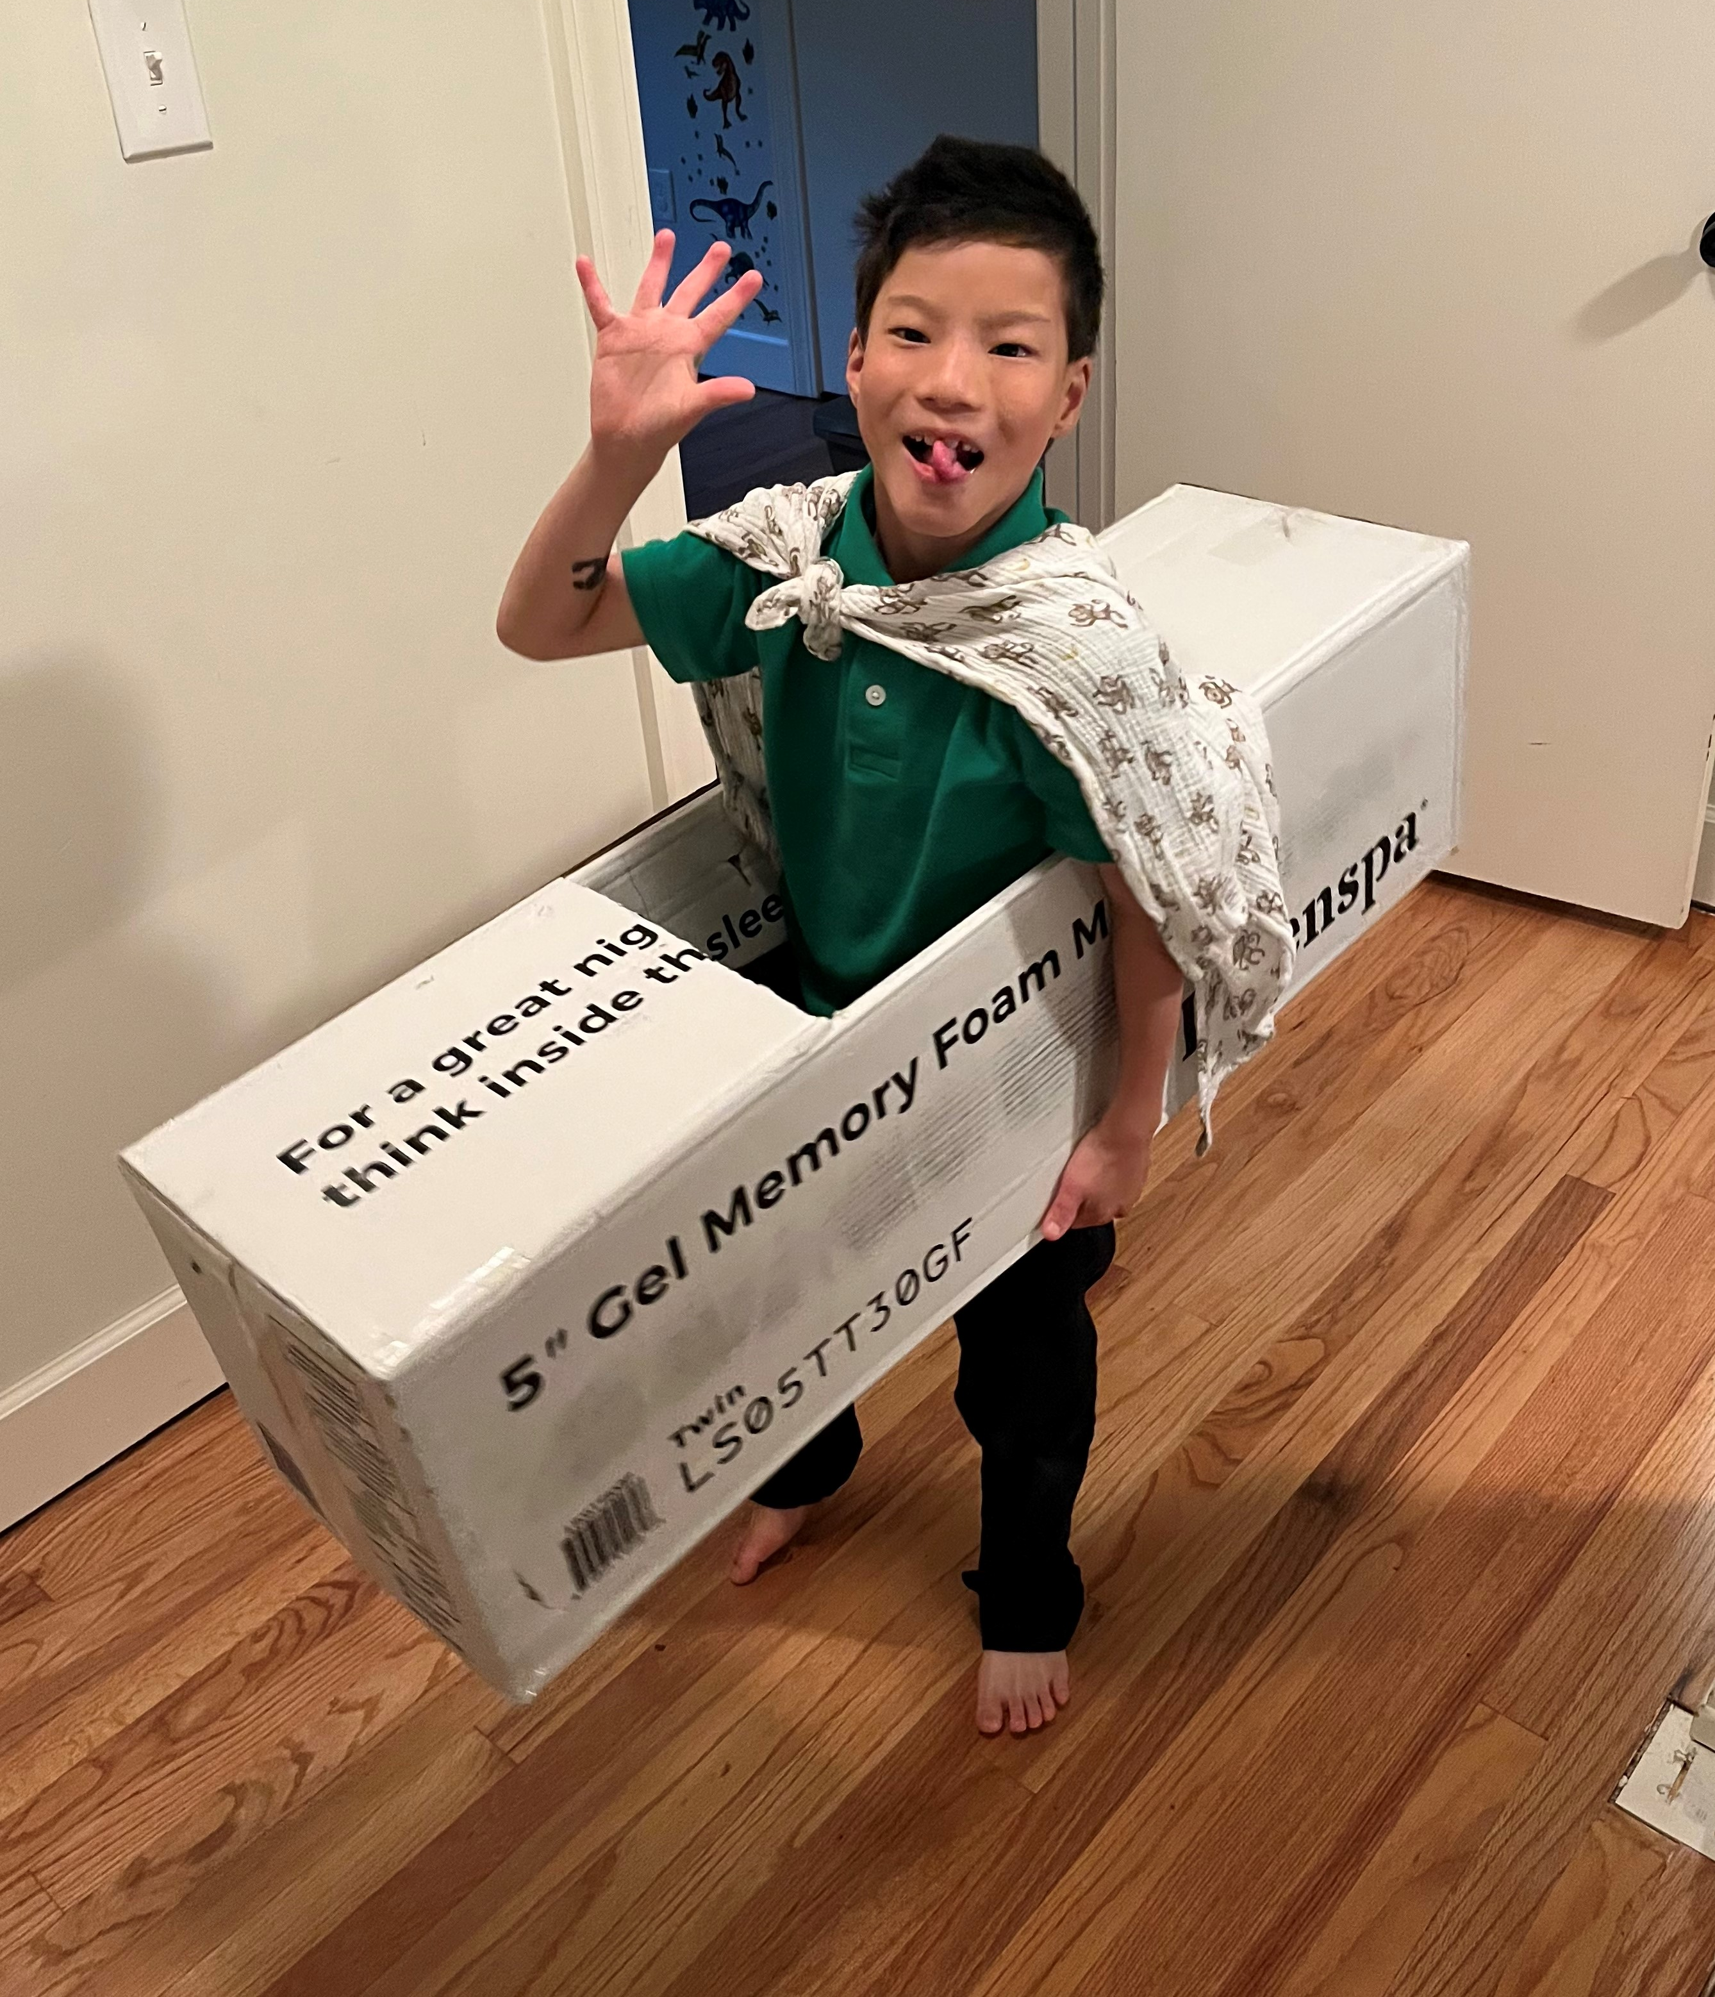
Thank You
Melissa Turpin, OTD, OTR/L, CTP
mkturpin@presby.edu
Let’s connect on LinkedIn
Notes:
Thank you so much for joining us this afternoon for the beginning of the 2023 ICE Webinar Series. If you have any additional questions, suggestions, or would just like to connect, please send me an email or find me on LinkedIn.

